Slide 1
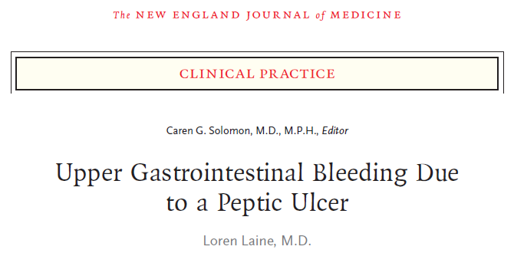
Reporter : R1 林柏任

Slide 2
Scenario
A 55-year-old woman presents to the emergency department at 11:30 p.m. with hematemesis. She is otherwise healthy and has no risk factors for liver disease. Her only medication is aspirin (at a dose of 81 mg daily), which she started to take 6 months ago after reading that it reduces the risk of heart disease.
BP 94/60 mmHg, HR 108 bpm
Hb 11 g/dL, plt 220k, INR 1.0, BUN 20mg/dL
How should this case be further evaluated and managed?

Slide 3
The clinical problem
UGI bleeding: bleeding from the esophagus, stomach, or duodenum
Peptic ulcer ( No.1 cause of UGI bleeding)
Helicobacter pylori, NSAIDS
Stomach or duodenum
Erosions: breaks confined to the mucosa
Esophagus (GERD)
Stomach or duodenum (NSAID)

Slide 4
The clinical problem
Mallory–Weiss tears
linear tears that usually occur on the gastric side of the gastroesophageal junction,
may cause severe bleeding
usually occur after retching or vomiting
Less common causes of nonvariceal UGI bleeding
neoplasms
vascular ectasias,
Dieulafoy’s lesions (aberrant vessels in the mucosa)
bleeding from the bile duct or pancreatic duct
aortoenteric fistulas

Slide 5
Strategies and evidence

Slide 6
Initial assessment
Risk assessment
tachycardia (HR ≥100 bpm)
hypotension (SBP ≤100 mmHg)
age > 60 y/o
major coexisting conditions
Glasgow–Blatchford score are available and useful in identifying patients at very low risk

Slide 7
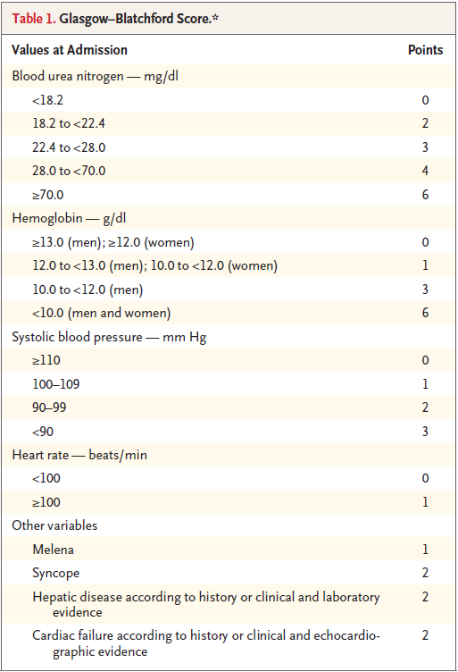
Score 0-1 or 0-2 (age < 70): when hospitalized, < 1% require intervention, < 0.5% die

Slide 8
Initial therapy before endoscopy
Transfusion is recommended if Hb < 7g/dL (lower mortality, rebleeding and adverse events rate compared to Hb < 9g/dL )
Hemodynamically stable and preexisting cardiovascular disease:
Transfusion if Hb < 8g/dL
Hypotension and hemodynamically unstable
Transfusion when Hb > 7g/dL

Slide 9
Initial therapy before endoscopy
PPI use soon after UGI bleeding present did not significantly reduce the risks of further bleeding, surgery, or death (6 RCT trials, meta)
It decrease in the frequency of high-risk endoscopic findings (active bleeding, a nonbleeding visible vessel, or an adherent clot) and the need for endoscopic therapy
Guidelines vary substantively

Slide 10
Initial therapy before endoscopy
Erythromycin (250 mg IV 30 mins before endoscopy) increases gastric motility and improves visualization of the gastric mucosa at endoscopy
It decreased the need for blood transfusion and repeat endoscopy (4 RCT trials, meta)

Slide 11
Initial therapy before endoscopy
A nasogastric tube is not required in patients with upper gastrointestinal bleeding
It do not allow sufficient clearance of clots to substantially improve visualization of the gastric mucosa at endoscopy

Slide 12
Endoscopy
Hospitalized patients: endoscopy < 24hrs
Prompt v.s > 24hrs: reductions in the need for surgery, length of hospitalization, and mortality
Endoscopy within 12-13 hrs in patients with high clinical risk (Glasgow–Blatchford score ≥12, bloody NG aspirate, hypotension, and tachycardia) may be associated with improved outcomes

Slide 13
Endoscopy
Endoscopic features of ulcers
predicting risk
determining management strategies
Rates of serious further bleeding if no intervention
spurting hemorrhage: 60%
non-bleeding visible vessels: 35%
oozing hemorrhage: 25%
adherent clot: 0-35%
flat, pigmented spots: 5.6%
Clean-base ulcers: 0.5%

Slide 14
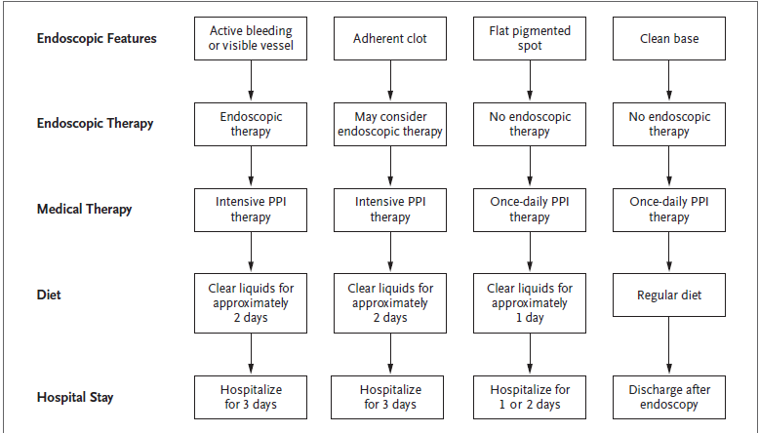
Intensive proton-pump inhibitor (PPI) therapy is an intravenous bolus (80 mg) followed by an infusion (8 mg per hour) for 72 hours or an oral or intravenous bolus (e.g., 80 mg) followed by intermittent high-dose PPI therapy (e.g.,40 to 80 mg twice daily) for 3 days

Slide 15
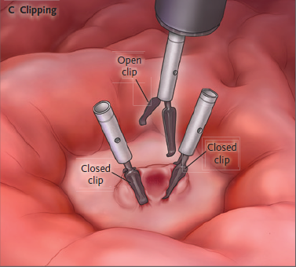

Slide 16
Endoscopy
Reductions in further bleeding
58%↓ in active bleeing
20%↓ in nonbleeding visible vessels
If bleeding recurs
PES > surgery
surgery was avoided in 73% of cases
adverse events were significantly less common

Slide 17
Endoscopy
TAE or surgery indicated if repeat PES fails
Complications of bleeding or perforation (PES) => 0.5%
PES
Vascular ectasias
Dieulafoy’s lesions
Neoplasms
Actively bleeding Mallory–Weiss tears

Slide 18
Endoscopy
Biopsy from lesion-free areas of the gastric body and antral mucosa for assessment of H.P (83% sens. and 100% spec.)
If negative, redo stool test or breath test

Slide 19
Care after endoscopy
Intensive PPI therapy recommended that patients with ulcers and high-risk endoscopic findings
Significantly reduced risks of further bleeding, the need for surgery, and mortality
Intermittent oral or IV PPI (40-80mg BID * 3d) ≈ continuous PPI infusion

Slide 20
Care after endoscopy
Rebleeding was uncommon > 3 days after endoscopy
Patient’s with ulcers and high-risk endoscopic findings typically are hospitalized for 3 days
Review of 5 RCT trials
44% after 3 days
24% after 7 days
11 % over 30 days

Slide 21
Care after endoscopy
Patients who presented with high-risk endoscopic findings and clinical factors (hemodynamic instability, older age, or a major coexisting condition): PPI 1# BID * 2wks then 1# QD (rebleeding rate 11% vs. 29%)

Slide 22
Prevention of recurrent bleeding

Slide 23
H. Pylori infection
12-month follow-up showed a 26% rebleeding rate among patients with H. pylori–associated bleeding ulcers who did not receive treatment
Confirmation after eradication of H. pylori
Breath test, stool test, biopsy when repeat PES
Avoid bismuth or anti > 4wks, PPI > 2wks (H2 blocker is permissible)

Slide 24
Low dose aspirin
Primary prevention, NNT = 1745
=> Hold aspirin if UGI bleeding
Secondary prevention, NNT = 67
=> Aspirin should be resumed 1 to 7 days after
bleeding stops, +PPI use
<24hrs v.s >8wks :
no significant bleeding risk↑
significantly lower mortality at 30 days (1% vs. 9%) and 8 weeks (1% vs. 13%)
The risk of cardiovascular events may increase within 1 to 2 weeks after discontinuing aspirin

Slide 25
Combined H.P infection and NSAID use
Both eradication of H. pylori infection and discontinuation of NSAIDs are recommended
12 months RCT: even after eradication of H. pylori infection, ulcer rebleeding was significantly less frequent with a PPI than with a placebo (2% vs. 15%)

Slide 26
Area of uncertainty
The appropriate dosing of PPI in high risk patients
Interventional radiologic vs. surgical treatment if PES failed
Observational studies show associations between PPIs and adverse outcomes (e.g., dementia, CKD, CV events, fractures, pneumonia, and enteric infections), HR < 2
Benefit of PPI outweighs the small and uncertain risks

Slide 27
Conclusions and recommedations

Slide 28
Answers for the scenario
IV NS + recheck Hb level
PES < 12hrs due to hypotension and tachycardia
If ulcer detected, endoscopic therapy for active bleeding or a nonbleeding visible vessel, perform biopsies of the gastric mucosa to detect H. pylori,
Initiate treatment with a PPI, and discontinue aspirin (primary prevention)

Slide 29
Answers for the scenario
H. pylori not present, PPI for 6-8 weeks
H. pylori detected, therapy for H. pylori infection for 2 weeks, followed by 2-4 weeks of a proton-pump inhibitor
Confirm eradication of the infection by retesting for H. pylori, then H2-blocker for 2 weeks

Slide 30
Intensive proton-pump inhibitor (PPI) therapy is an intravenous bolus (80 mg) followed by an infusion (8 mg per hour) for 72 hours or an oral or intravenous bolus (e.g., 80 mg) followed by intermittent high-dose PPI therapy (e.g.,40 to 80 mg twice daily) for 3 days

Slide 31
Prevention of recurrent bleeding

Slide 32
Thanks For Your Attention!

